Slide 1
MALIGNANT COMMENT CLASSIFIER
Problem Statement:
The background for the problem originates from the multitude of online forums, where-in people participate actively and make comments. As the comments some times may be abusive, insulting or even hate-based, it becomes the responsibility of the hosting organizations to ensure that these conversations are not of negative type. The task was thus to build a model which could make prediction to classify the comments into various categories. Consider the following examples :

Slide 2
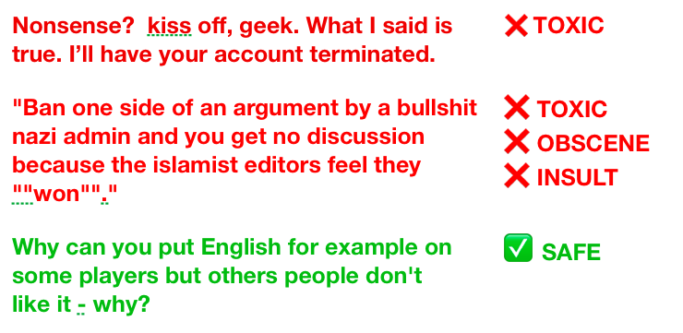
Example showing 2 toxic and 1 non-toxic comment.

Slide 3
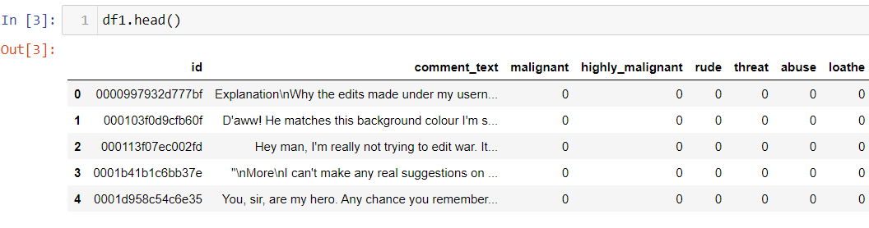
Studying data & identifying hidden patterns
The data set contains the training set, which has approximately 1,59,000 samples and the test set which contains nearly 1,53,000 samples. All the data samples contain 8 fields which includes ‘Id’, ‘Comments’, ‘Malignant’, ‘Highly malignant’, ‘Rude’, ‘Threat’, ‘Abuse’ and ‘Loathe’.
The label can be either 0 or 1, where 0 denotes a NO while 1 denotes a YES. There are various comments which have multiple labels. The first attribute is a unique ID associated with each comment.

Slide 4
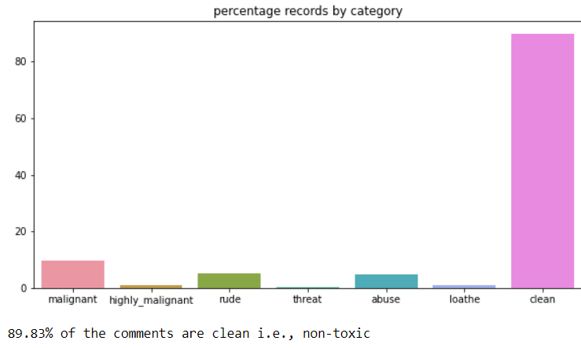
EDA And Visualization
Percentage of data vs Category:
This is clearly as case with high class imbalance

Slide 5
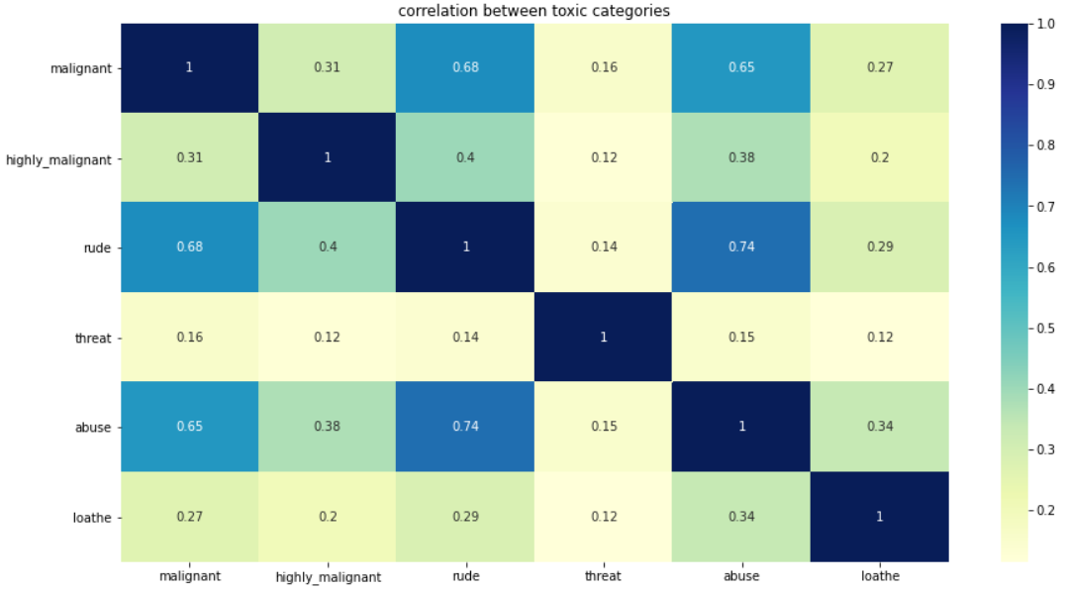
Correlation and Interrelation :
Correlation between labels:
Abuse and Rude, Malignant and Rude exhibit a strong correlation

Slide 6
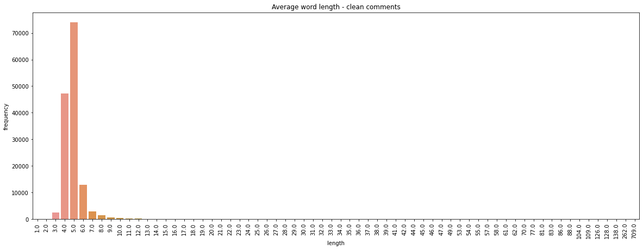
Average word length in clean and toxic comments :
The average word length in both clean and toxic comments is unreasobaly high;
we need to clean the data and inspect further, if the issue persists

Slide 7
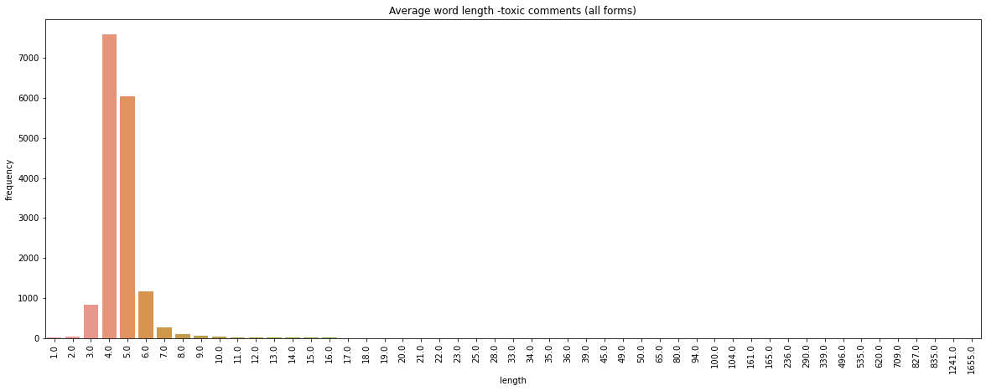

Slide 8
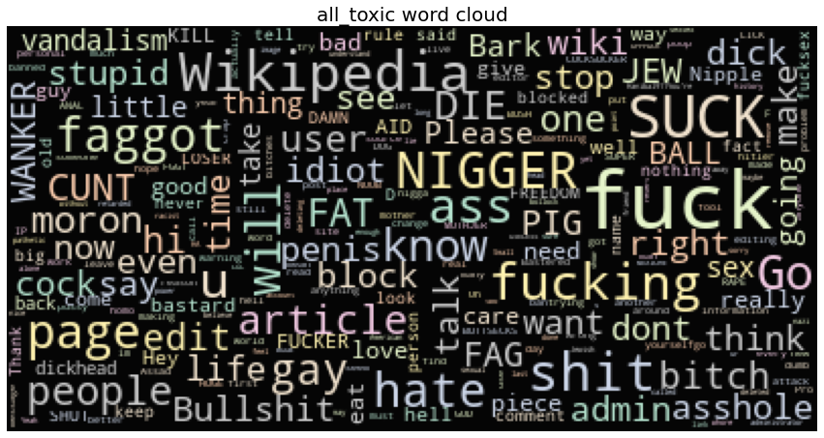
Wordclouds - unprocessed data :
We observe a heavy use of upper-cased, racist text (offensive nouns) in toxic comments
Clean comments on the other had fewer nouns and no observable upper case text

Slide 9
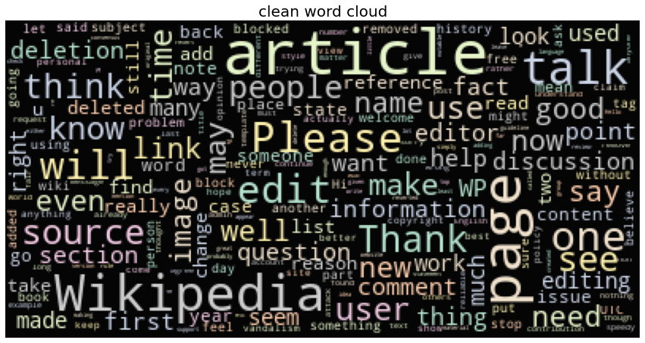

Slide 10
Text cleaning
Next step is to remove unnecessary elements from text.
It is important to note that this "unnecessary text" elimination process
could be more successful when followed in a particular sequence.
For instance, elimination of special characters before removal of
hashtags, usernames defeats our purpose as the text following a '#' could be
considered a token.
Here is the sequence we will implement:
HTML codes (if present)
URLs/ email addresses
Hashtags/Usernames
Emojis
Stopwords
Expanding Abbreviations
Punctuations
Special characters/ Numbers

Slide 11
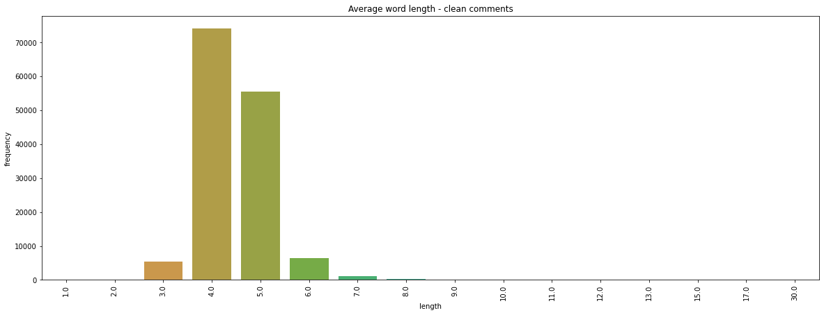
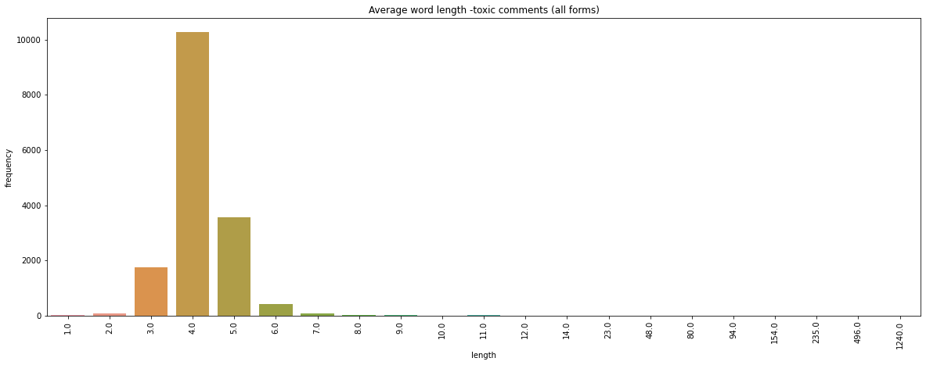
Average word lengths acrcoss toxic and clean comment categories (after cleaning):
Word lengths still look unusual!

Slide 12
Assumptions used to complete the project:
The goal is to create a classifier model that can predict if input text is inappropriate (toxic). 1. Explore the dataset to get a better picture of how the labels are distributed, how they correlate with each other, and what defines toxic or clean comments. 2. Create a baseline score with a simple logistic regression classifier. 3. Explore the effectiveness of multiple machine learning approaches and select the best for this problem. 4. Select the best model and tune the parameters to maximize performance. 5. Build a the final model with the best performing algorithm and parameters and test it on a holdout subset of the data

Slide 13
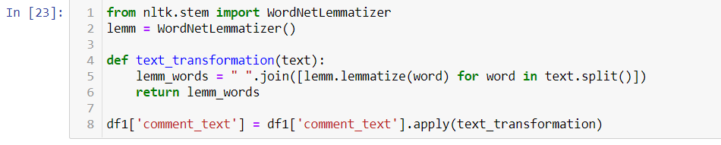
Training the model
Text transformation:
Using lemmatization to convert words to their
base form

Slide 14
Non-semantic Approaches:
Bag of words techniques do not take into consideration the order of words in a given text. These techniques are primarily concerned with number of occurences of words in the text.
There are three ways in which we could vectorize text:
Count Vectorizer
Tfidf Vectorizer
Hashing Vectorizer

Slide 15
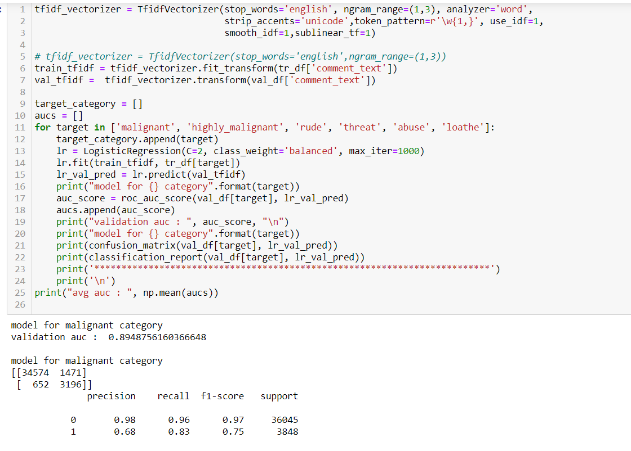
Logistic Regression:

Slide 16
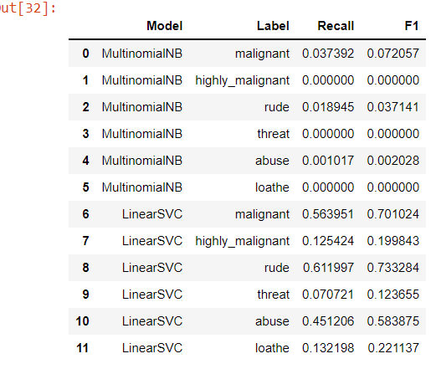
Training on some more models :

Slide 17
Conclusion:
Reflection:
The process for this project was as follows:
Analyze the problem and propose a useful solution.
Explore the dataset to get a better picture of how the labels are distributed, how they correlate with each other, and what defines toxic or clean comments.
Develop an objective that fits a practical use case and addresses the major class imbalance.
Create a baseline score with a simple logistic regression classifier.
Explore the effectiveness of multiple machine learning algorithms.
Select the best model based on a balance of performance and efficiency.
Refine the preprocessing strategies to optimize model performance.
Tune model parameters to maximize performance.
Build a the final model with the best performing algorithm and parameters and test it on a holdout subset of the data.
The most difficult yet most interesting aspect of the project was understanding the relationship between the size of input data and the performance of various machine learning algorithms.
Improvement:
I believe that there are a number of ways that the solution could be improved.
Recurrent neural networks offer extremely high performance on natural language processing problems, and if the architecture for the inferrence step were implemented efficiently the computational overhead would be minimal.
Another great strategy could be using multiple models, a sort of divide an conquer method where the problem is divided into multiple smaller, contextual problems. While the solution laid out here generalizes to the entire dataset, no one solution will be able to generalize perfectly to the diverse variety of inputs you’ll get from Internet users. By training models on different situations, like a model that’s only been trained on short or long comments, to only detect whether a comment is toxic when profanity is present, etc, and storing them in memory, you could use a simple decision tree to feel comments into the model that would be most effective. A few that I can think of are:
Short comments
Long comments
We can also make class imbalance balanced.

